Slide 1
1. Getting Down With Business
Topic 1. Getting Down With Business
Chapter 1. Business Basics.
Unit 1. The Context of Business.
MXA101 – Introduction To Business
-By ManageX Academy

Slide 2
Introduction
Meaning of business in simple terms
Why understanding business basics matters
Profit as a core objective
Real-world relevance across industries

Slide 3
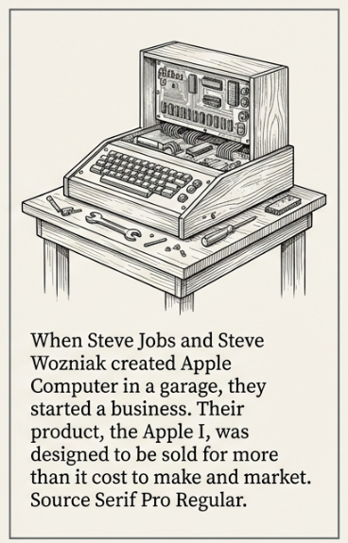
What Is a Business?
Business as an economic activity
Goods vs services
Value creation for customers
Profit as reward for risk

Slide 4
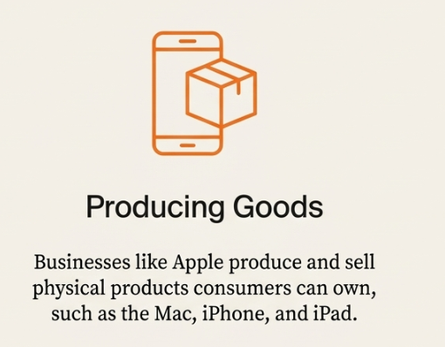
Goods-Based Businesses
Tangible products
Manufacturing examples
Inventory and production focus
Scalability advantages

Slide 5

Service-Based Businesses
Intangible offerings
Customer experience driven
Human skill dependency
Examples from daily life

Slide 6
Businesses Offering Both Goods and Services
Hybrid business models
Product + service integration
Customer lifetime value focus
Competitive differentiation

Slide 7

For-Profit vs Nonprofit Organizations
Profit motive vs social objective
Revenue usage differences
Operational similarities
Why business principles still apply

Slide 8
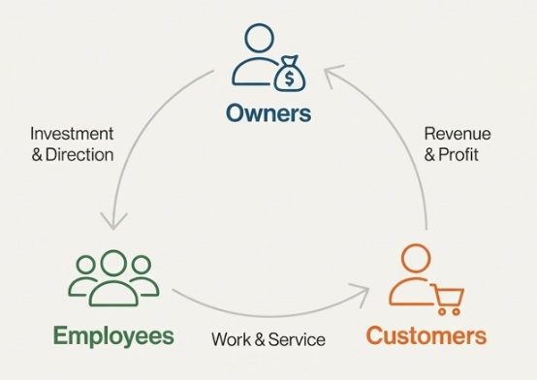
Key Participants in a Business
Owners
Employees
Customers
Interdependency among participants

Slide 9
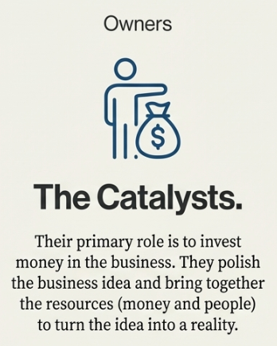
Role of Owners
Capital investment
Vision and strategy
Risk bearing
Long-term decision-making

Slide 10

Role of Employees
Skill and execution
Operational efficiency
Value delivery
Organizational culture

Slide 11

Role of Customers
Demand creation
Revenue source
Feedback loop
Market survival factor

Slide 12
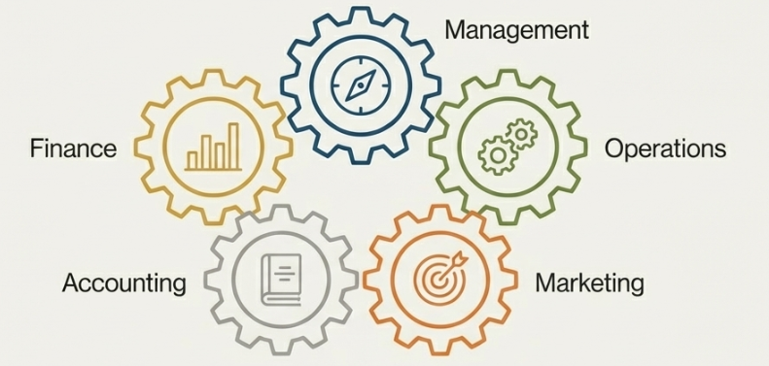
Functional Areas of Business – Overview
Management
Operations
Marketing
Accounting
Finance

Slide 13
Management Function
Planning
Organizing
Staffing
Directing
Controlling

Slide 14
Operations Function
Input to output transformation
Quality control
Productivity focus
Cost efficiency

Slide 15
Marketing Function
Customer need identification
Product design
Pricing and promotion
Relationship building

Slide 16
Accounting Function
Financial reporting
Cost tracking
Performance measurement
Decision support

Slide 17
Finance Function
Capital requirement planning
Fund sourcing
Investment decisions
Risk management

Slide 18
External Business Environment
Businesses don’t operate in isolation
External dependency
Risk and uncertainty
Strategic adaptability

Slide 19

Economic Environment
Income levels
Inflation and interest rates
Business cycles
Purchasing power impact

Slide 20

Government & Legal Environment
Regulations
Taxation
Compliance requirements
Policy impact

Slide 21

Consumer Trends
Changing preferences
Lifestyle shifts
Technology adoption
Demand volatility

Slide 22

Corporate Social Responsibility Pressure
Ethical expectations
Environmental responsibility
Sustainable practices
Brand trust building

Slide 23
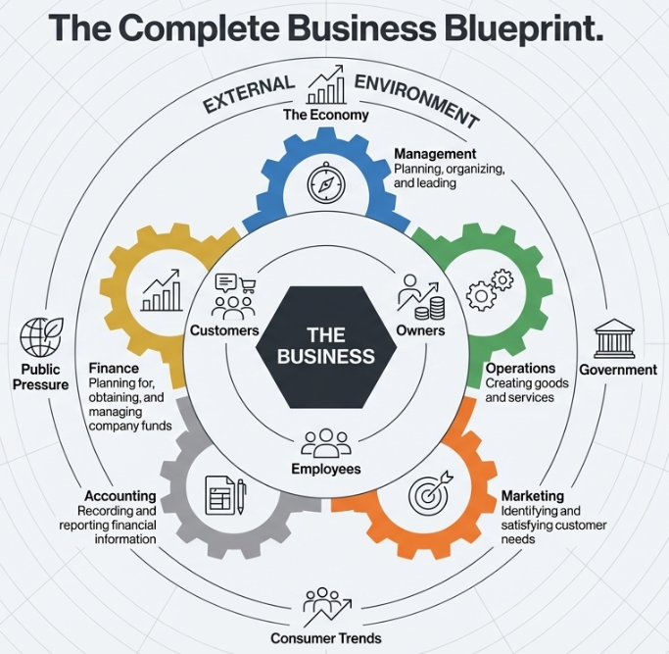
Business Environment – Integrated View
Internal + external alignment
Strategic balance
Long-term sustainability
Competitive advantage

Slide 24
Key Takeaways
Business fundamentals recap
Importance of functional alignment
External awareness necessity
Why managers must think holistically

Slide 25


